Slide 1
WILCOXON MANN-WHITNEY Test
A SIMULATION STUDY
Payel Ghosal

Slide 2
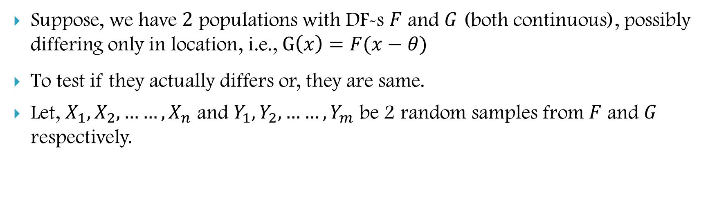
INTRODUCTION
Suppose, we have $2$ populations with DF-s $F$ and $G$ (both continuous), possibly differing only in location, i.e., $G\left(x\right)=F(x−θ)$
To test if they actually differs or, they are same.
Let, $X_{1}, X_{2},……,X_{n}$ and $Y_{1}, Y_{2},……, Y_{m}$ be 2 random samples from $F$ and $G$ respectively.

Slide 3
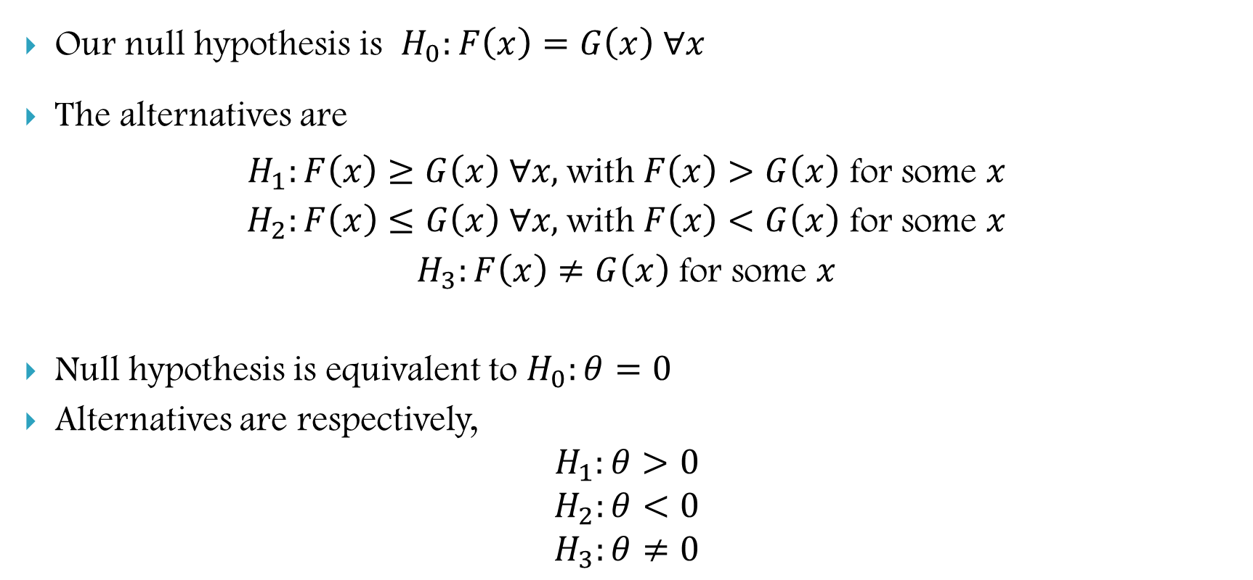
INTRODUCTION
Our null hypothesis is $H_{0}:F\left(x\right)=G\left(x\right) ∀x$
The alternatives are
$H_{1}:F\left(x\right)≥G\left(x\right) ∀x,$with $F\left(x\right)>G\left(x\right)$ for some $x$
$H_{2}:F\left(x\right)≤G\left(x\right) ∀x,$with $F\left(x\right)<G\left(x\right)$ for some $x$
$H_{3}:F\left(x\right)≠G\left(x\right)$ for some $x$
Null hypothesis is equivalent to $H_{0}:θ=0$
Alternatives are respectively,
$$H_{1}:θ>0$$
$$H_{2}:θ<0$$
$$H_{3}:θ≠0$$

Slide 4
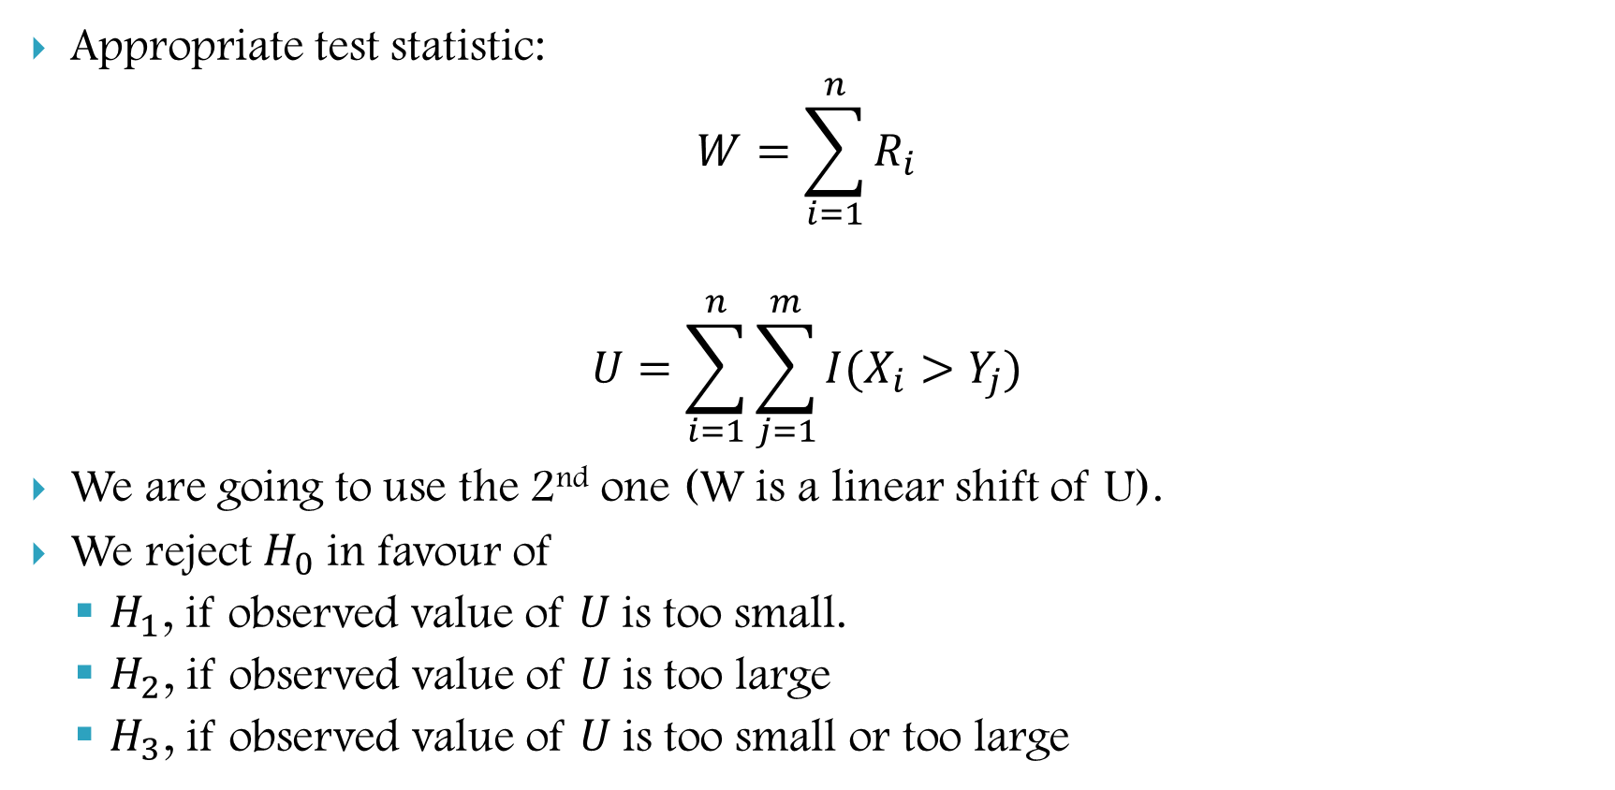
INTRODUCTION
Appropriate test statistic:
$$W=\sum_{i=1}^{n}{R_{i}}$$
$$U=\sum_{i=1}^{n}{\sum_{j=1}^{m}{I(X_{i}>Y_{j})}}$$
We are going to use the 2nd one (W is a linear shift of U).
We reject $H_{0}$in favour of
$H_{1}$, if observed value of $U$is too small.
$H_{2}$, if observed value of $U$is too large
$H_{3}$, if observed value of $U$is too small or too large

Slide 5
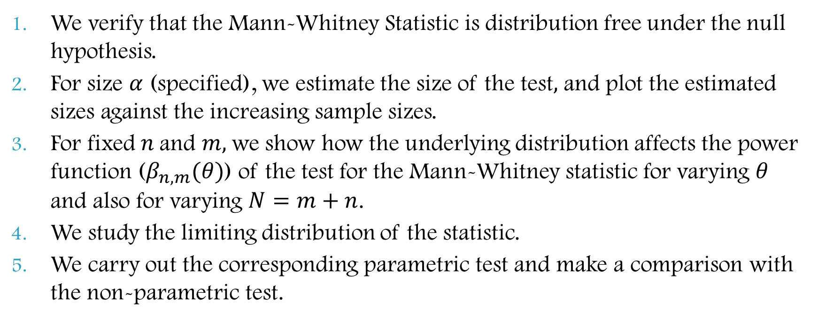
What we discuss here
We verify that the Mann-Whitney Statistic is distribution free under the null hypothesis.
For size $α$ (specified), we estimate the size of the test$,$ and plot the estimated sizes against the increasing sample sizes.
For fixed $n$and $m,$we show how the underlying distribution affects the power function ($β_{n,m}(θ)$) of the test for the Mann-Whitney statistic for varying $θ$ and also for varying $N=m+n$.
We study the limiting distribution of the statistic.
We carry out the corresponding parametric test and make a comparison with the non-parametric test.

Slide 6
DISTRIBUTION OF STATISTIC

Slide 7
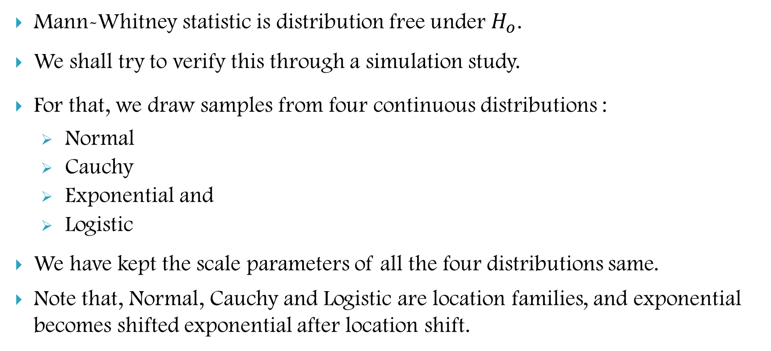
DISTRIBUTION FREE
Mann-Whitney statistic is distribution free under $H_{o}$.
We shall try to verify this through a simulation study.
For that, we draw samples from four continuous distributions :
Normal
Cauchy
Exponential and
Logistic
We have kept the scale parameters of all the four distributions same.
Note that, Normal, Cauchy and Logistic are location families, and exponential becomes shifted exponential after location shift.

Slide 8
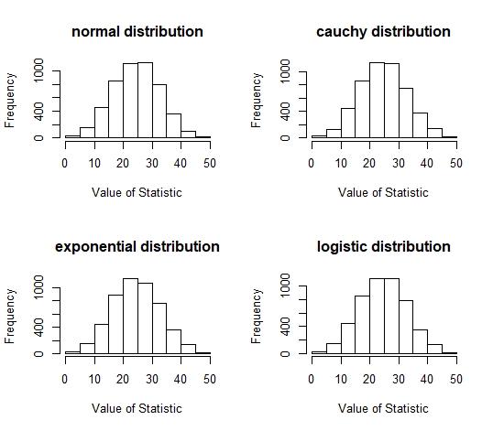
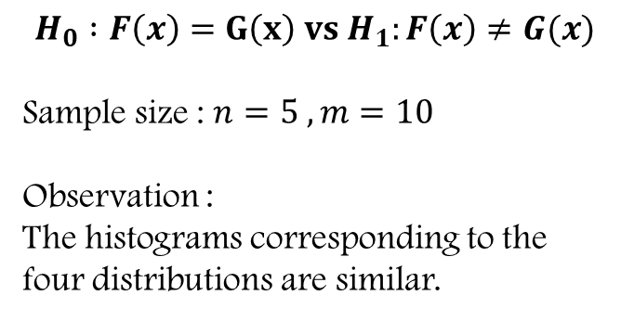
$$H_{0} :F\left(x\right)=G\left(x\right) vs H_{1}:F\left(x\right)≠G(x)$$
Sample size : $n=5 , m=10$
Observation :
The histograms corresponding to the four distributions are similar.

Slide 9
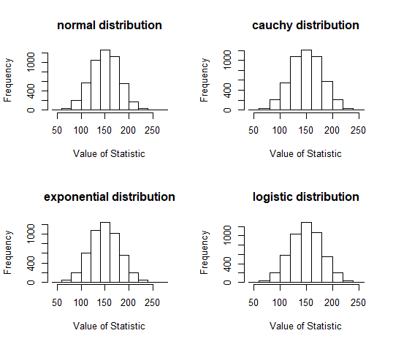
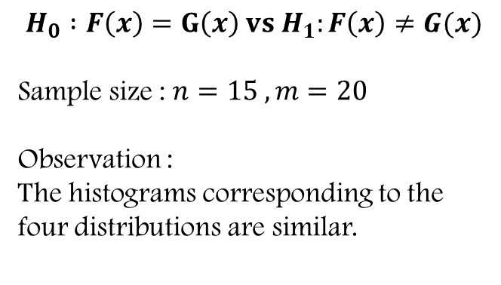
$$H_{0} :F\left(x\right)=G\left(x\right) vs H_{1}:F\left(x\right)≠G(x)$$
Sample size : $n=15 , m=20$
Observation :
The histograms corresponding to the four distributions are similar.

Slide 10
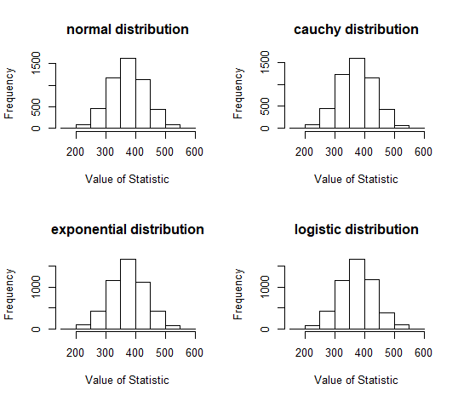
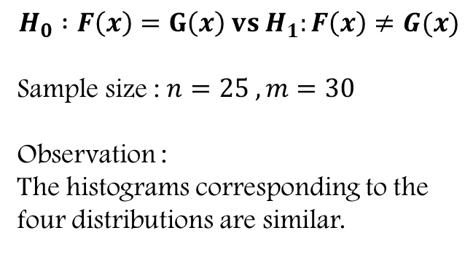
$$H_{0} :F\left(x\right)=G\left(x\right) vs H_{1}:F\left(x\right)≠G(x)$$
Sample size : $n=25 , m=30$
Observation :
The histograms corresponding to the four distributions are similar.

Slide 11
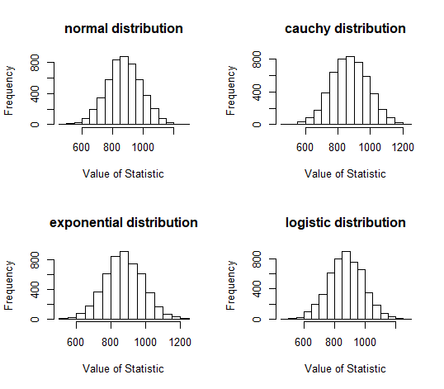
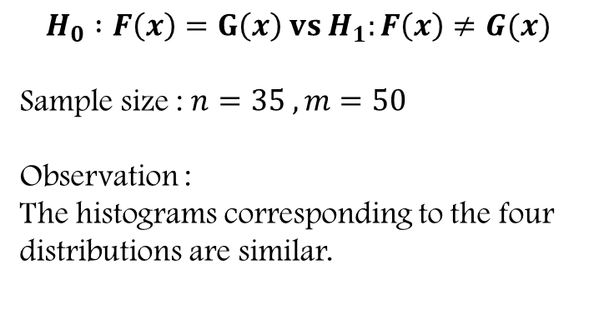
$$H_{0} :F\left(x\right)=G\left(x\right) vs H_{1}:F\left(x\right)≠G(x)$$
Sample size : $n=35 , m=50$
Observation :
The histograms corresponding to the four distributions are similar.

Slide 12
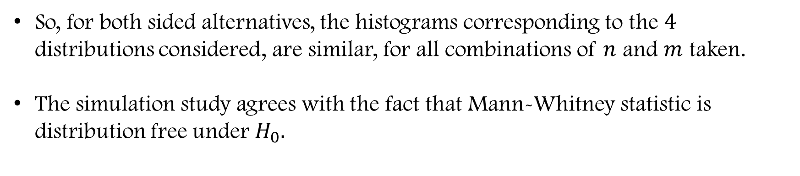
So, for both sided alternatives, the histograms corresponding to the $4$ distributions considered, are similar, for all combinations of $n$ and $m$ taken.
The simulation study agrees with the fact that Mann-Whitney statistic is distribution free under $H_{0}.$

Slide 13
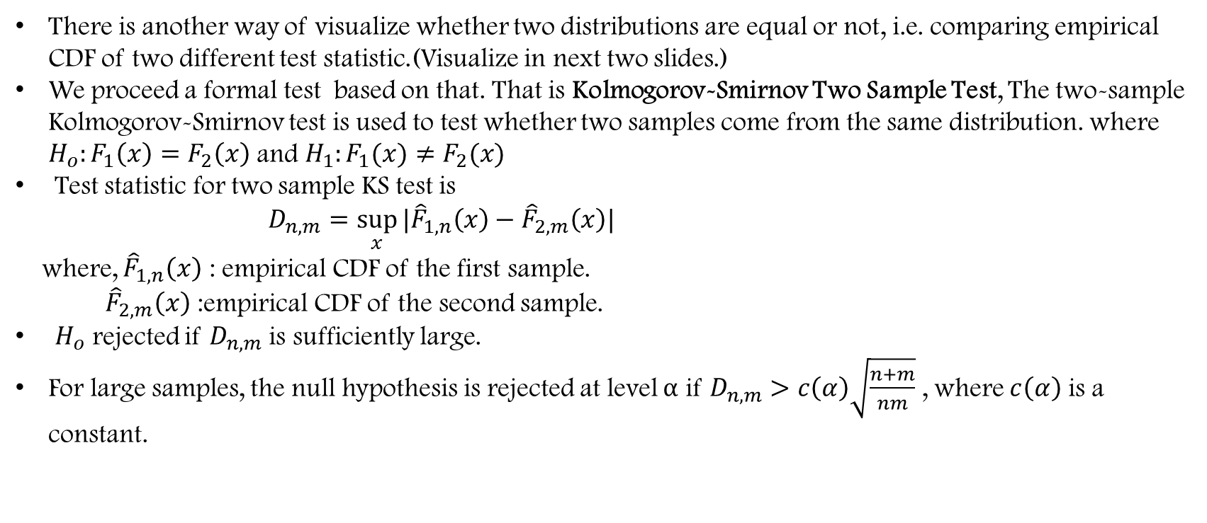
ANOTHER WAY OF VISUALIZATION OF DISTRIBUTION FREE CHARACTERISTIC
There is another way of visualize whether two distributions are equal or not, i.e. comparing empirical CDF of two different test statistic.(Visualize in next two slides.)
We proceed a formal test based on that. That is Kolmogorov-Smirnov Two Sample Test, The two-sample Kolmogorov-Smirnov test is used to test whether two samples come from the same distribution. where $H_{o}:F_{1}\left(x\right)=F_{2}\left(x\right)$ and $H_{1}:F_{1}(x)≠F_{2}(x)$
Test statistic for two sample KS test is
$D_{n,m}=\sup_{x}{|{\hat{F}}_{1,n}\left(x\right)−{\hat{F}}_{2,m}\left(x\right)|}$
where, ${\hat{F}}_{1,n}\left(x\right)$ : empirical CDF of the first sample.
${ \hat{F}}_{2,m}\left(x\right)$ :empirical CDF of the second sample.
$H_{o}$ rejected if $D_{n,m}$ is sufficiently large.
For large samples, the null hypothesis is rejected at level $α$ if $D_{n,m}>c\left(α\right)\sqrt{\frac{n+m}{nm}}$ , where $c\left(α\right)$ is a constant.

Slide 14
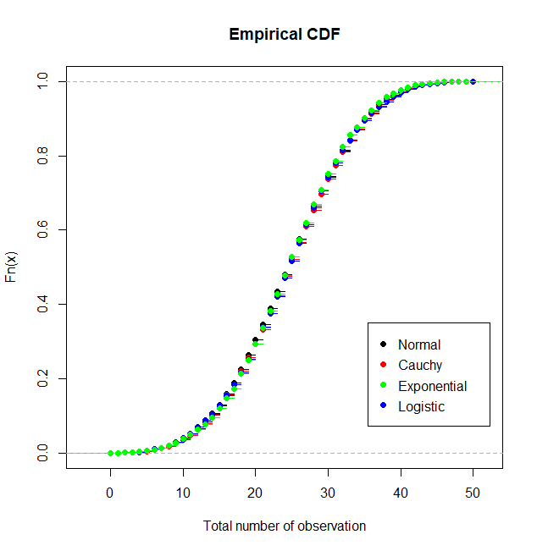
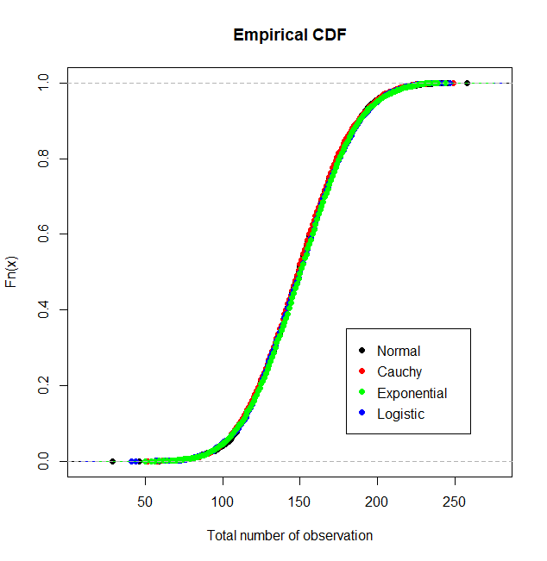
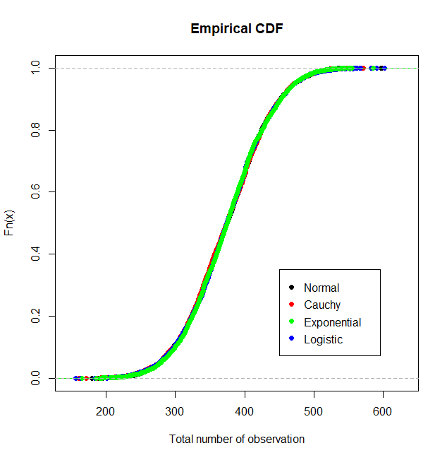
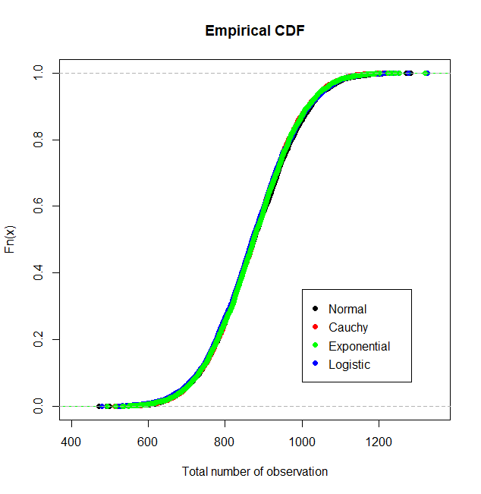




$$n=5,m=10$$
$$n=15,m=20$$
$$n=25,m=30$$
$$n=35,m=50$$

Slide 15
p-values for KOLMOGOROV-SMIRNOV TEST
SAMPLE SIZE | NORMAL vs CAUCHY | NORMAL vs EXPONENTIAL | NORMAL vs LOGISTIC | CAUCHY vs EXPONENTIAL | CAUCHY vs LOGISTIC | EXPONENTIAL vs LOGISTIC
n=5 m=10 | 0.836 | 0.992 | 0.864 | 0.836 | 0.527 | 0.877
n=15 m=20 | 0.998 | 0.352 | 0.511 | 0.327 | 0.123 | 0.987
n=25 m=30 | 0.694 | 0.610 | 0.975 | 0.877 | 0.822 | 0.776
n=35 m=50 | 0.135 | 0.135 | 0.694 | 0.259 | 0.170 | 0.511

Slide 16
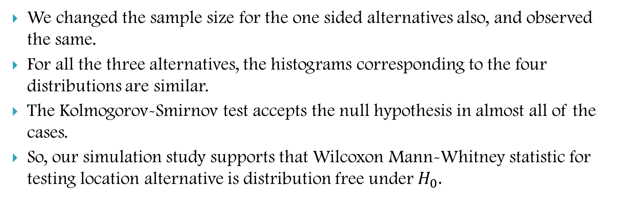
Observations :
We changed the sample size for the one sided alternatives also, and observed the same.
For all the three alternatives, the histograms corresponding to the four distributions are similar.
The Kolmogorov-Smirnov test accepts the null hypothesis in almost all of the cases.
So, our simulation study supports that Wilcoxon Mann-Whitney statistic for testing location alternative is distribution free under $H_{0}.$

Slide 17
PARAMETRIC COUNTERPART

Slide 18
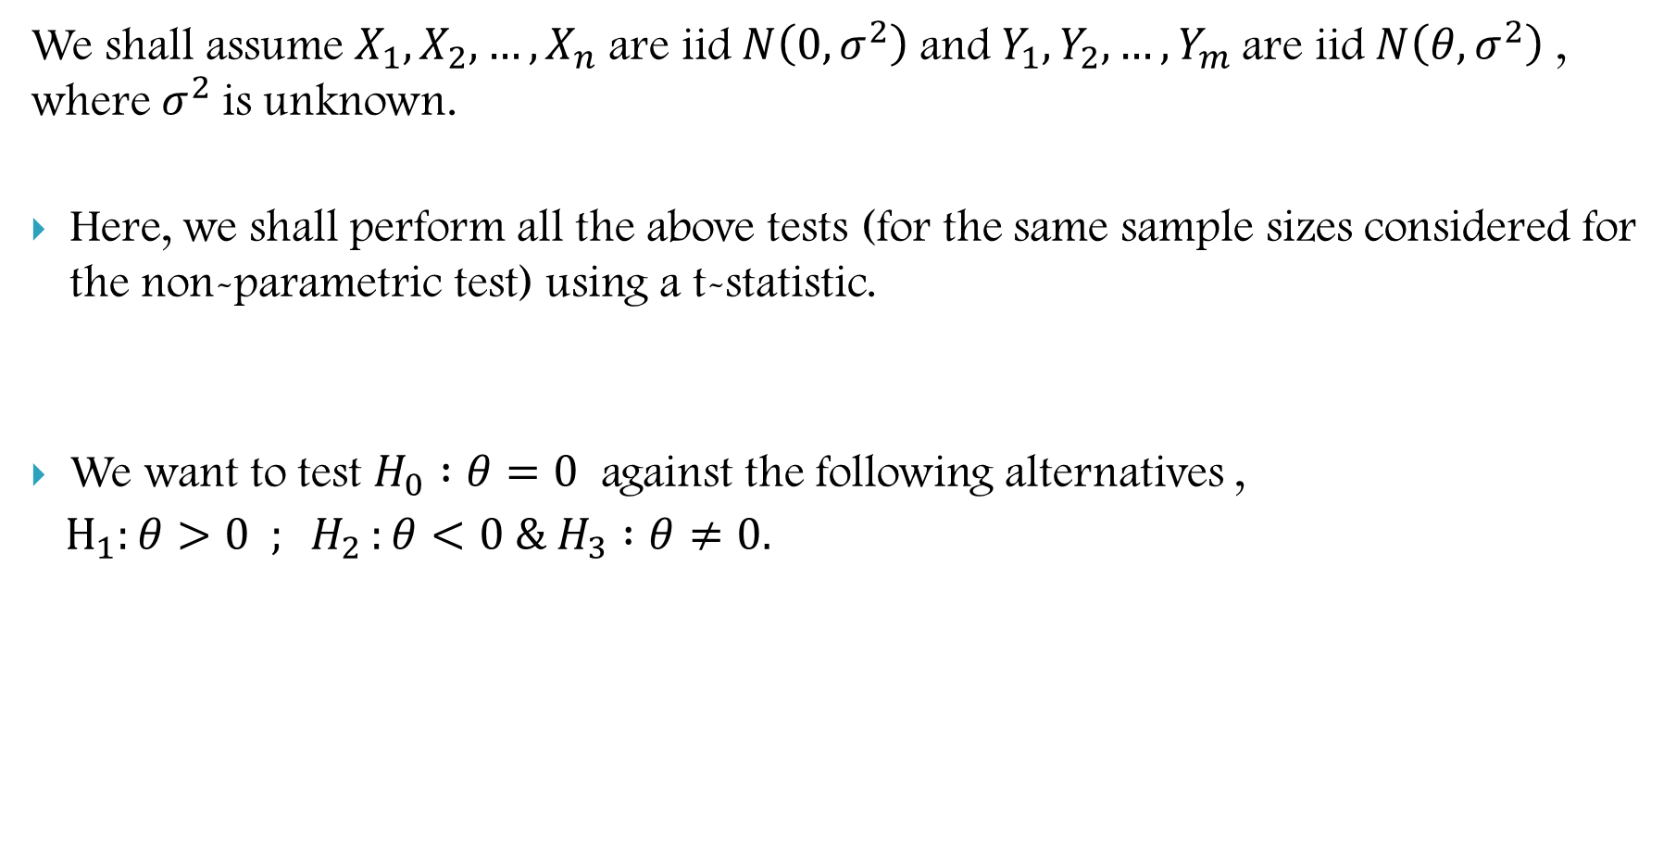
We shall assume $X_{1},X_{2},…,X_{n}$are iid$N\left(0,σ^{2}\right)$and $Y_{1},Y_{2},…,Y_{m}$are iid$N\left(θ,σ^{2}\right)$ , where $σ^{2}$is unknown.
Here, we shall perform all the above tests (for the same sample sizes considered for the non-parametric test) using a t-statistic.
We want to test $H_{0} :θ=0$ against the following alternatives ,
$H_{1}:θ>0 ; H_{2 }:θ<0 \& H_{3} :θ≠0.$

Slide 19
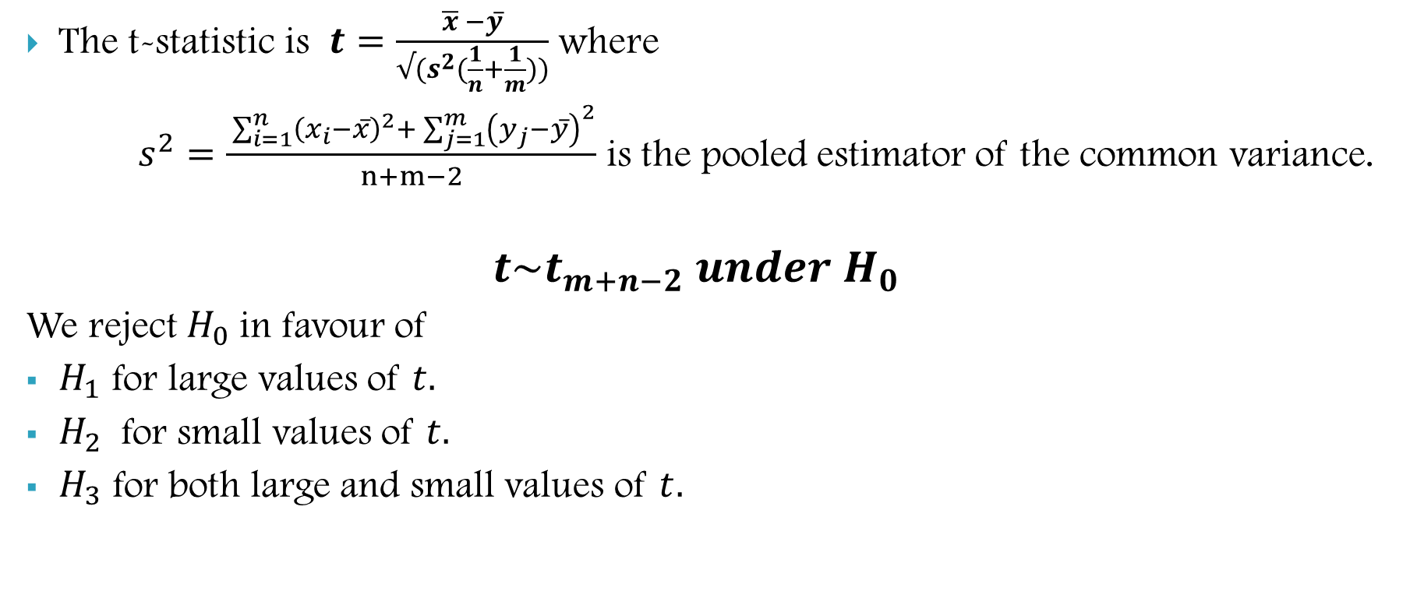
The t-statistic is $t=\frac{\overline{x} −y̅}{√(s^{2}(\frac{1}{n}+\frac{1}{m}))}$ where
$s^{2}=\frac{ \sum_{i=1}^{n}{{\left(x_{i}−x̅\right)}^{2}+ \sum_{j=1}^{m}{{\left(y_{j}−y̅\right)}^{2}}}}{n+m−2}$ is the pooled estimator of the common variance.
$$t\sim t_{m+n−2} under H_{0}$$
We reject $H_{0}$in favour of
$H_{1}$ for large values of $t.$
$H_{2}$ for small values of $t.$
$H_{3}$ for both large and small values of $t.$

Slide 20
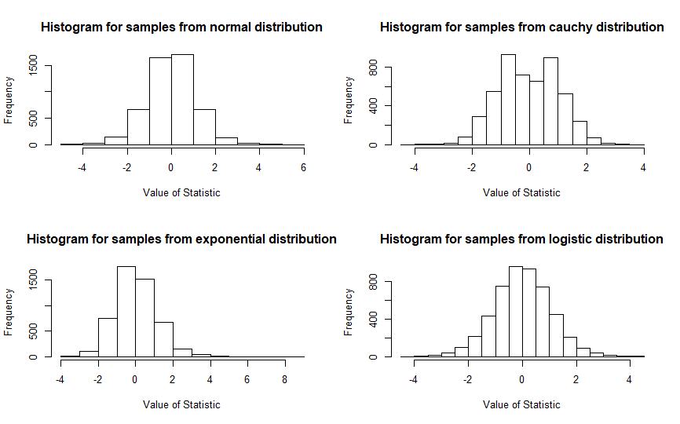
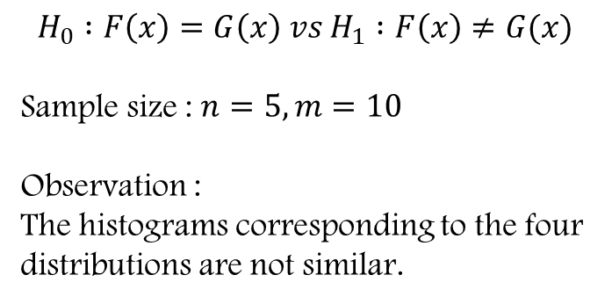
$$H_{0} :F\left(x\right)=G\left(x\right) vs H_{1} :F\left(x\right)≠G(x)$$
Sample size : $n=5, m=10$
Observation :
The histograms corresponding to the four distributions are not similar.

Slide 21
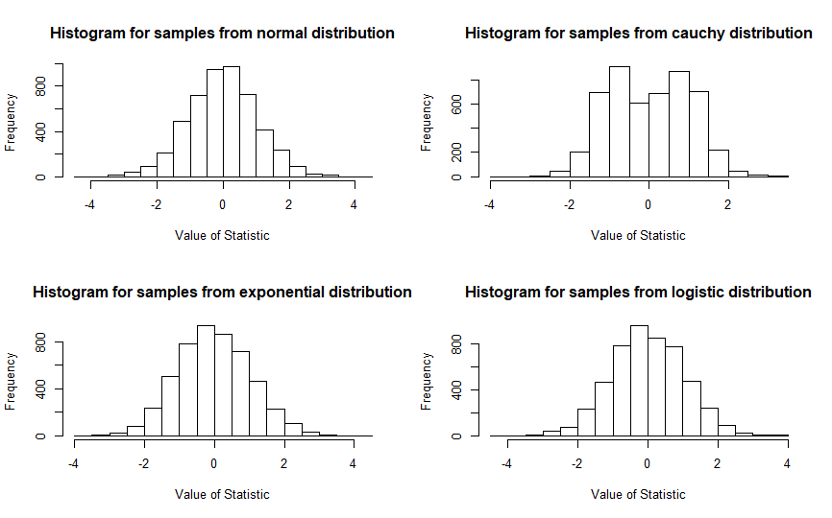
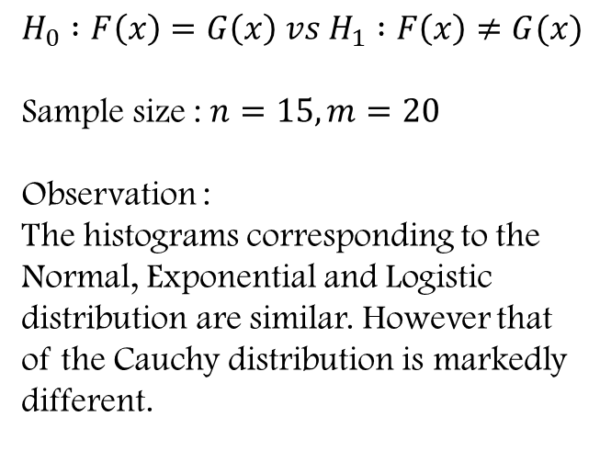
$$H_{0} :F\left(x\right)=G\left(x\right) vs H_{1} :F\left(x\right)≠G(x)$$
Sample size : $n=15, m=20$
Observation :
The histograms corresponding to the Normal, Exponential and Logistic distribution are similar. However that of the Cauchy distribution is markedly different.

Slide 22
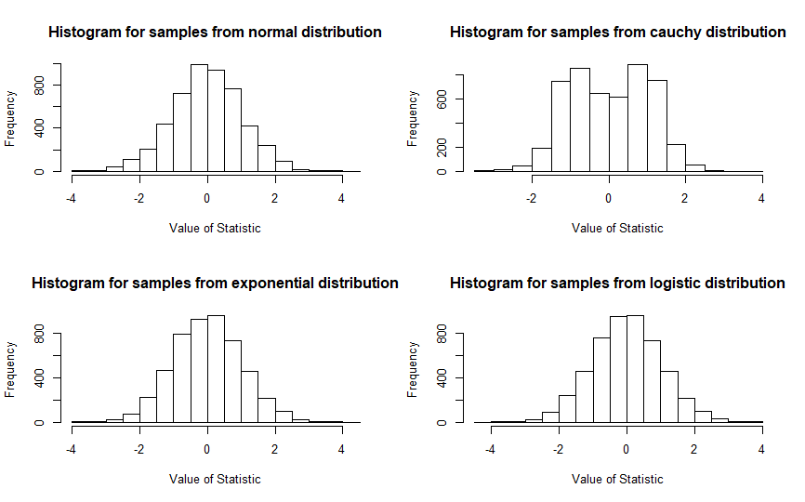
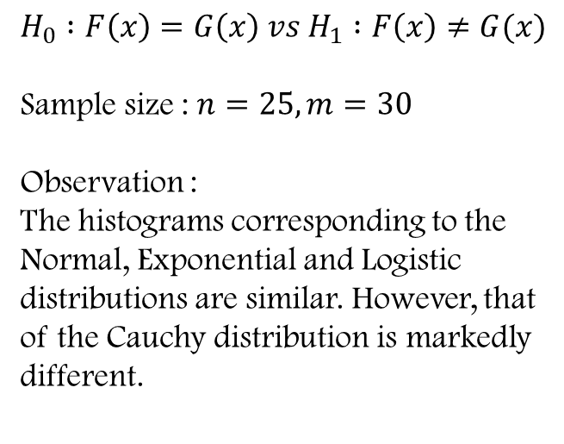
$$H_{0} :F\left(x\right)=G\left(x\right) vs H_{1} :F\left(x\right)≠G(x)$$
Sample size : $n=25, m=30$
Observation :
The histograms corresponding to the Normal, Exponential and Logistic distributions are similar. However, that of the Cauchy distribution is markedly different.

Slide 23
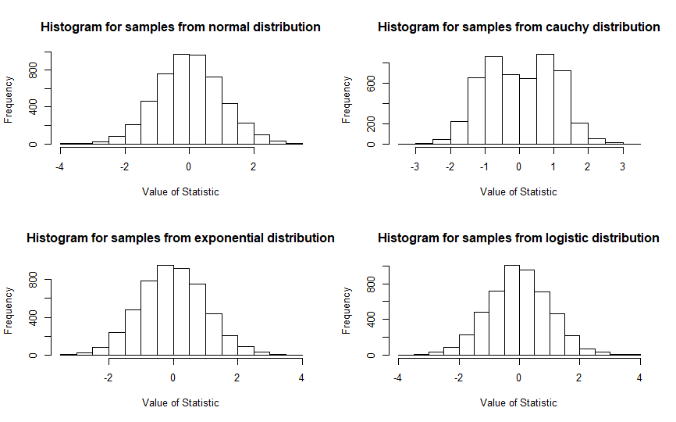
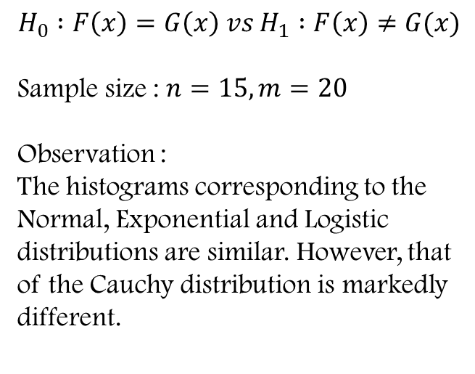
$$H_{0} :F\left(x\right)=G\left(x\right) vs H_{1} :F\left(x\right)≠G(x)$$
Sample size : $n=15, m=20$
Observation :
The histograms corresponding to the Normal, Exponential and Logistic distributions are similar. However, that of the Cauchy distribution is markedly different.

Slide 24
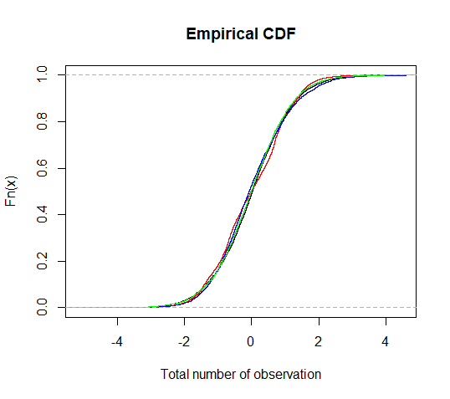
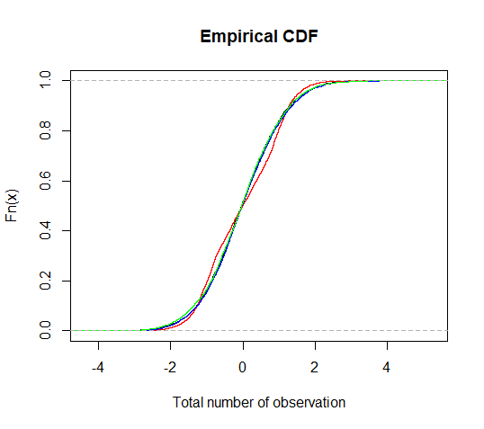
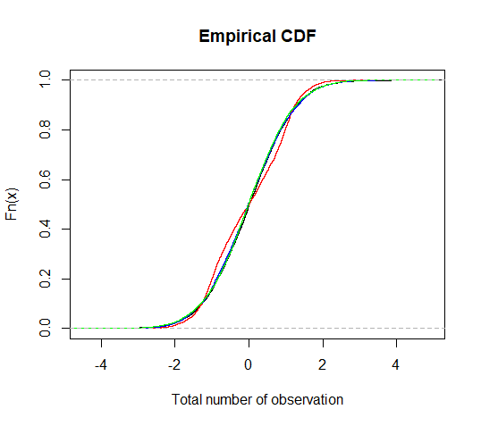
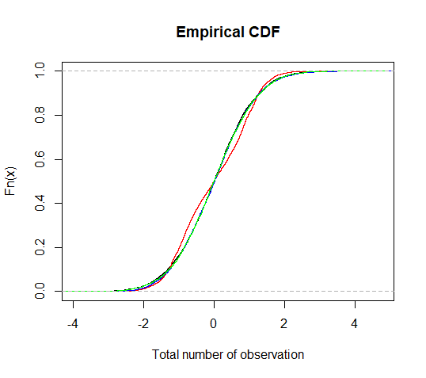



$$n=5,m=10$$
$$n=15,m=20$$
$$n=25,m=30$$
$$n=35,m=50$$

Slide 25
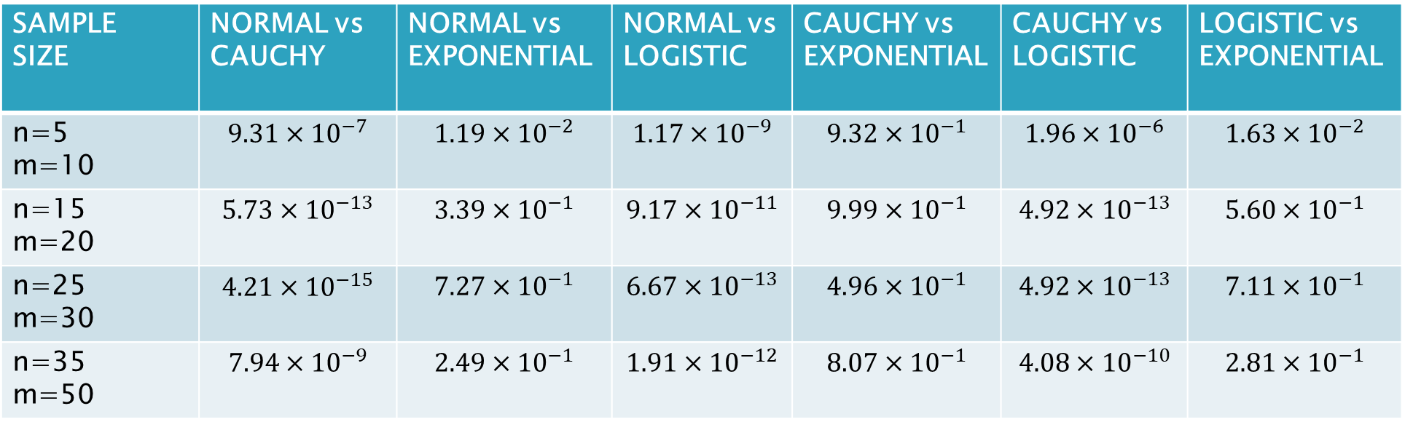
p-values for KOLMOGORV-SMIRNOV TEST
SAMPLE SIZE | NORMAL vs CAUCHY | NORMAL vs EXPONENTIAL | NORMAL vs LOGISTIC | CAUCHY vs EXPONENTIAL | CAUCHY vs LOGISTIC | LOGISTIC vs EXPONENTIAL
n=5 m=10 | $$9.31×{10}^{−7}$$ | $$1.19×{10}^{−2}$$ | $$1.17×{10}^{−9}$$ | $$9.32×{10}^{−1}$$ | $$1.96×{10}^{−6}$$ | $$1.63×{10}^{−2}$$
n=15 m=20 | $$5.73×{10}^{−13}$$ | $$3.39×{10}^{−1}$$ | $$9.17×{10}^{−11}$$ | $$9.99×{10}^{−1}$$ | $$4.92×{10}^{−13}$$ | $$5.60×{10}^{−1}$$
n=25 m=30 | $$4.21×{10}^{−15}$$ | $$7.27×{10}^{−1}$$ | $$6.67×{10}^{−13}$$ | $$4.96×{10}^{−1}$$ | $$4.92×{10}^{−13}$$ | $$7.11×{10}^{−1}$$
n=35 m=50 | $$7.94×{10}^{−9}$$ | $$2.49×{10}^{−1}$$ | $$1.91×{10}^{−12}$$ | $$8.07×{10}^{−1}$$ | $$4.08×{10}^{−10}$$ | $$2.81×{10}^{−1}$$

Slide 26
Observation :
In almost all of the cases, the Kolmogorov-Smirnov test rejects the null hypothesis in favour of the alternative hypothesis.
In some cases, the null hypothesis was accepted for Cauchy vs Exponential distributions, and Exponential vs Logistic distributions.

Slide 27
Limiting Distribution

Slide 28
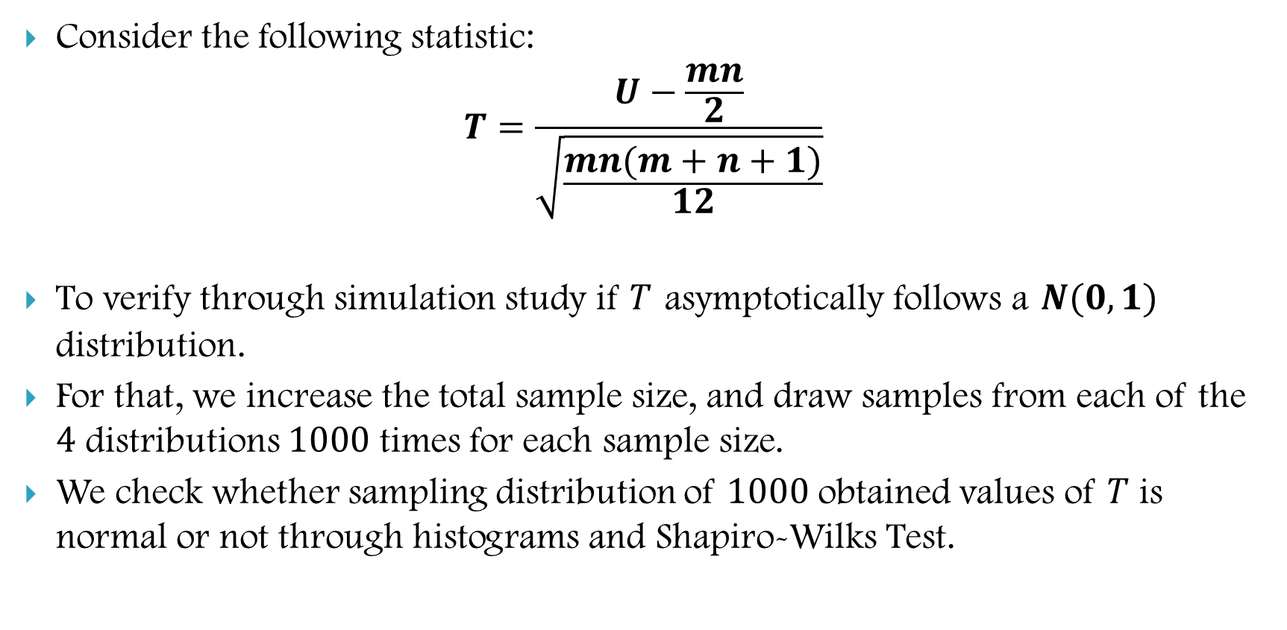
Non-Parametric Test
Consider the following statistic:
$$T=\frac{U−\frac{mn}{2}}{\sqrt{\frac{mn(m+n+1)}{12}}}$$
To verify through simulation study if $T$ asymptotically follows a $N(0,1)$ distribution.
For that, we increase the total sample size, and draw samples from each of the $4$ distributions $1000$ times for each sample size.
We check whether sampling distribution of $1000$ obtained values of $T$ is normal or not through histograms and Shapiro-Wilks Test.

Slide 29
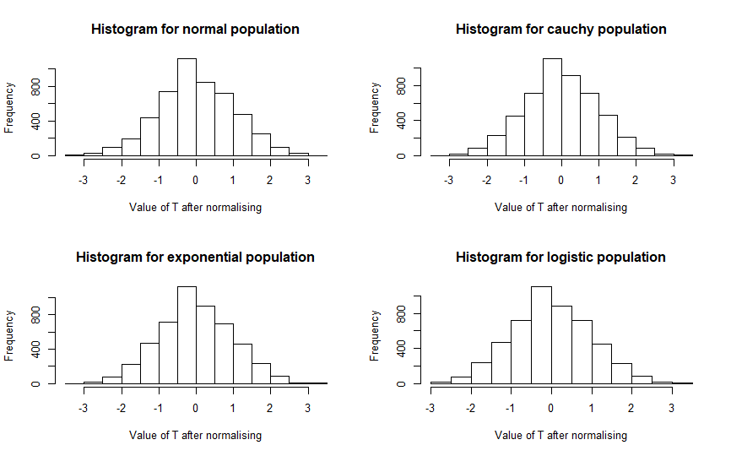
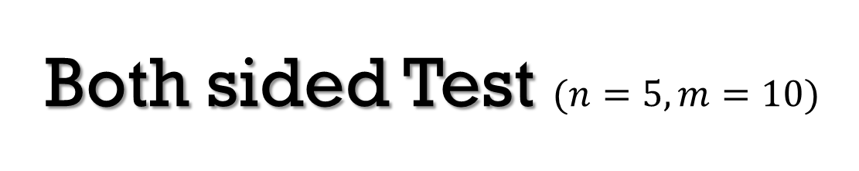
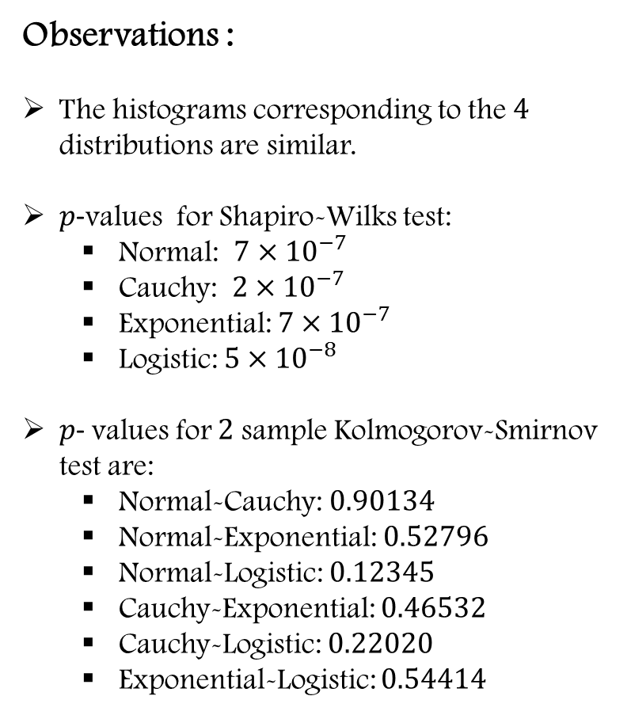
Both sided Test $(n=5,m=10)$
Observations :
The histograms corresponding to the $4$ distributions are similar.
$p$-values for Shapiro-Wilks test:
Normal: $7×{10}^{−7}$
Cauchy: $2×{10}^{−7}$
Exponential: $7×{10}^{−7}$
Logistic: $5×{10}^{−8}$
$p$- values for $2$ sample Kolmogorov-Smirnov test are:
Normal-Cauchy: $0.90134$
Normal-Exponential: $0.52796$
Normal-Logistic: $0.12345$
Cauchy-Exponential: $0.46532$
Cauchy-Logistic: $0.22020$
Exponential-Logistic: $0.54414$

Slide 30
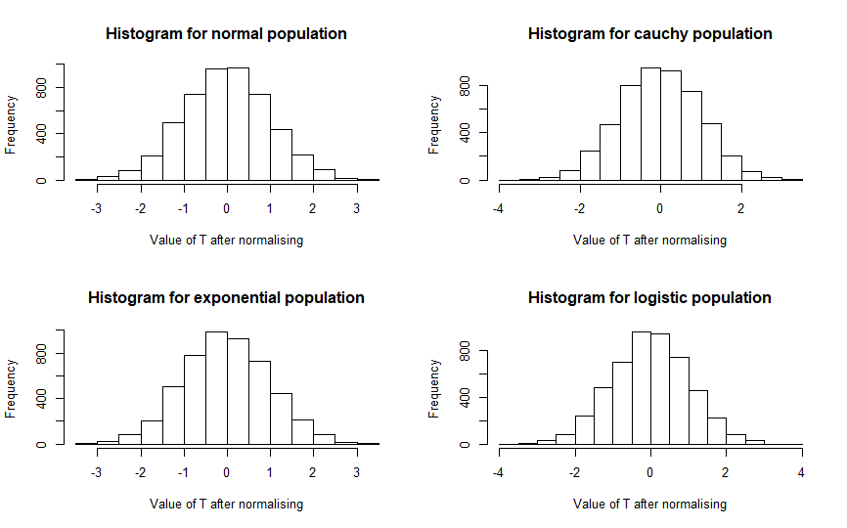
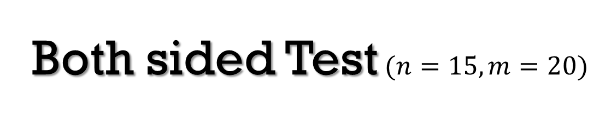
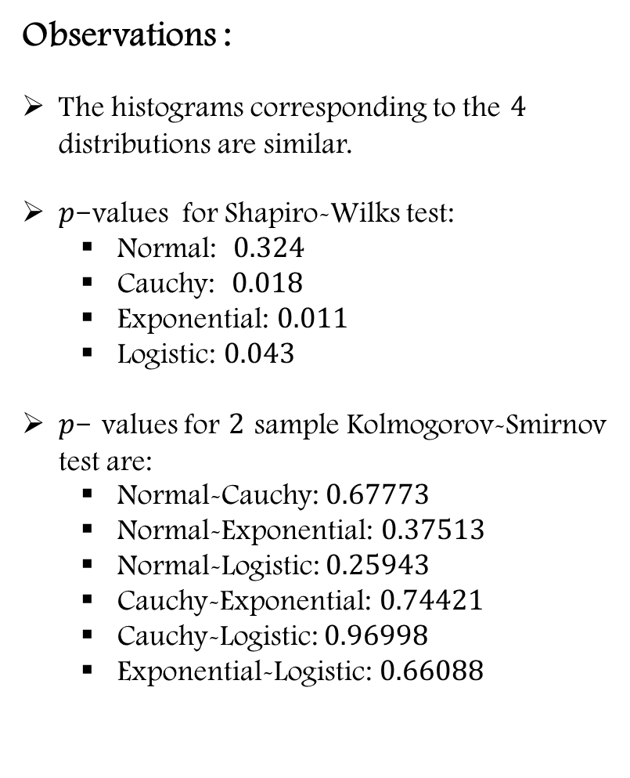
Both sided Test$(n=15,m=20)$
Observations :
The histograms corresponding to the $4$ distributions are similar.
$p$-values for Shapiro-Wilks test:
Normal: $0.324$
Cauchy: $0.018$
Exponential: $0.011$
Logistic: $0.043$
$p$- values for $2$ sample Kolmogorov-Smirnov test are:
Normal-Cauchy: $0.67773$
Normal-Exponential: $0.37513$
Normal-Logistic: $0.25943$
Cauchy-Exponential: $0.74421$
Cauchy-Logistic: $0.96998$
Exponential-Logistic: $0.66088$

Slide 31
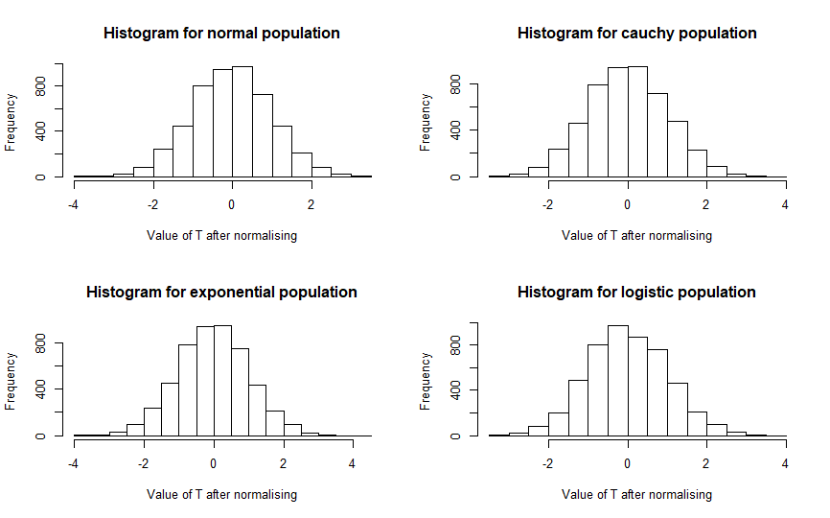
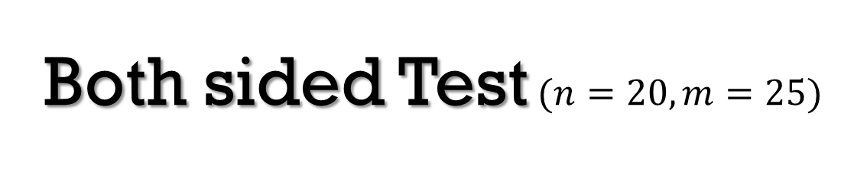
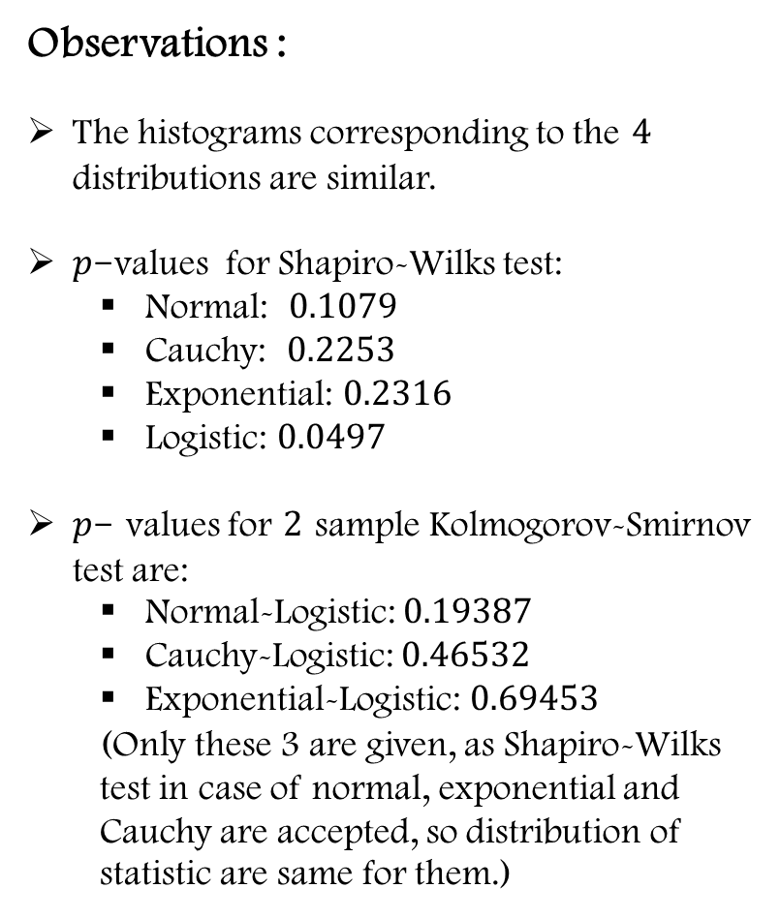
Both sided Test$(n=20,m=25)$
Observations :
The histograms corresponding to the $4$ distributions are similar.
$p$-values for Shapiro-Wilks test:
Normal: $0.1079$
Cauchy: $0.2253$
Exponential: $0.2316$
Logistic: $0.0497$
$p$- values for $2$ sample Kolmogorov-Smirnov test are:
Normal-Logistic: $0.19387$
Cauchy-Logistic: $0.46532$
Exponential-Logistic: $0.69453$
(Only these 3 are given, as Shapiro-Wilks test in case of normal, exponential and Cauchy are accepted, so distribution of statistic are same for them.)

Slide 32
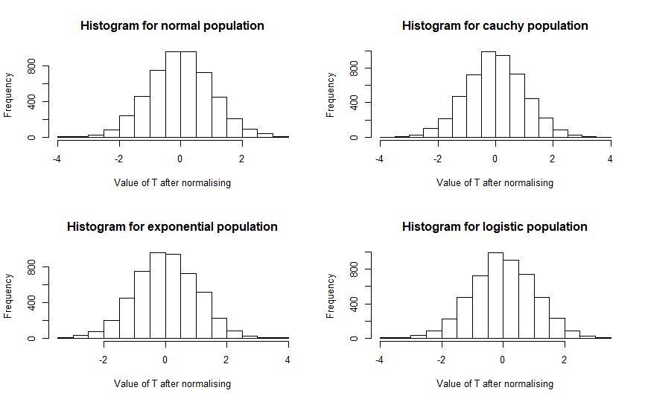
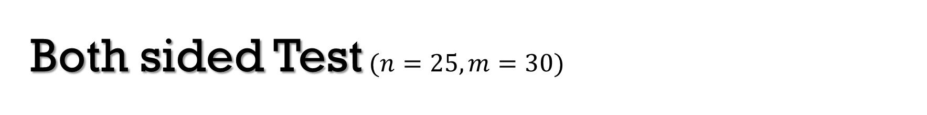
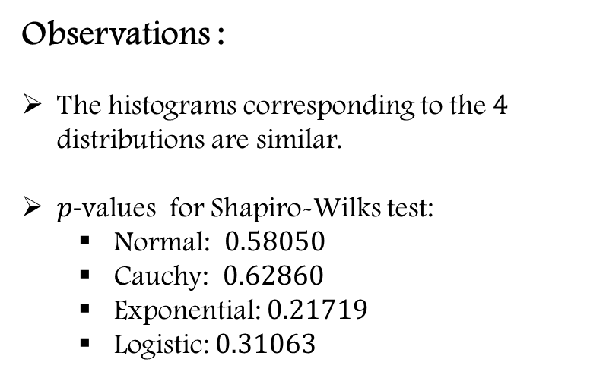
Both sided Test$(n=25,m=30)$
Observations :
The histograms corresponding to the $4$ distributions are similar.
$p$-values for Shapiro-Wilks test:
Normal: $0.58050$
Cauchy: $0.62860$
Exponential: $0.21719$
Logistic: $0.31063$

Slide 33
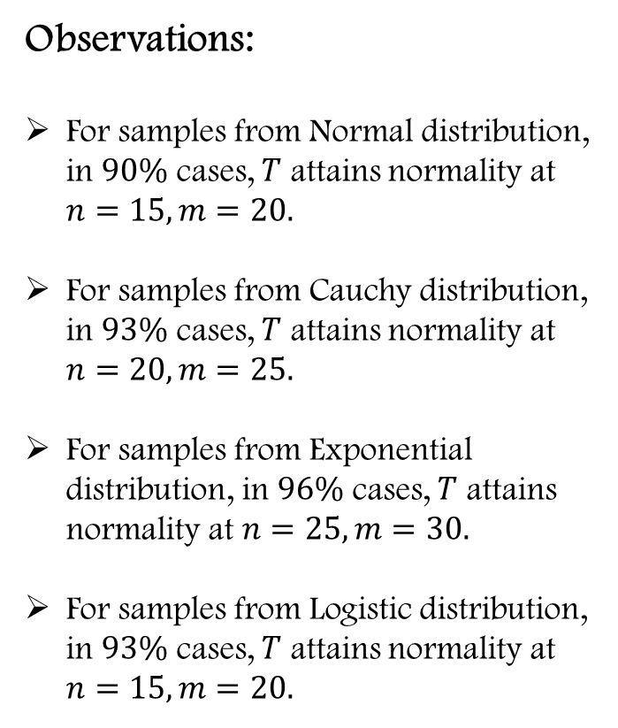
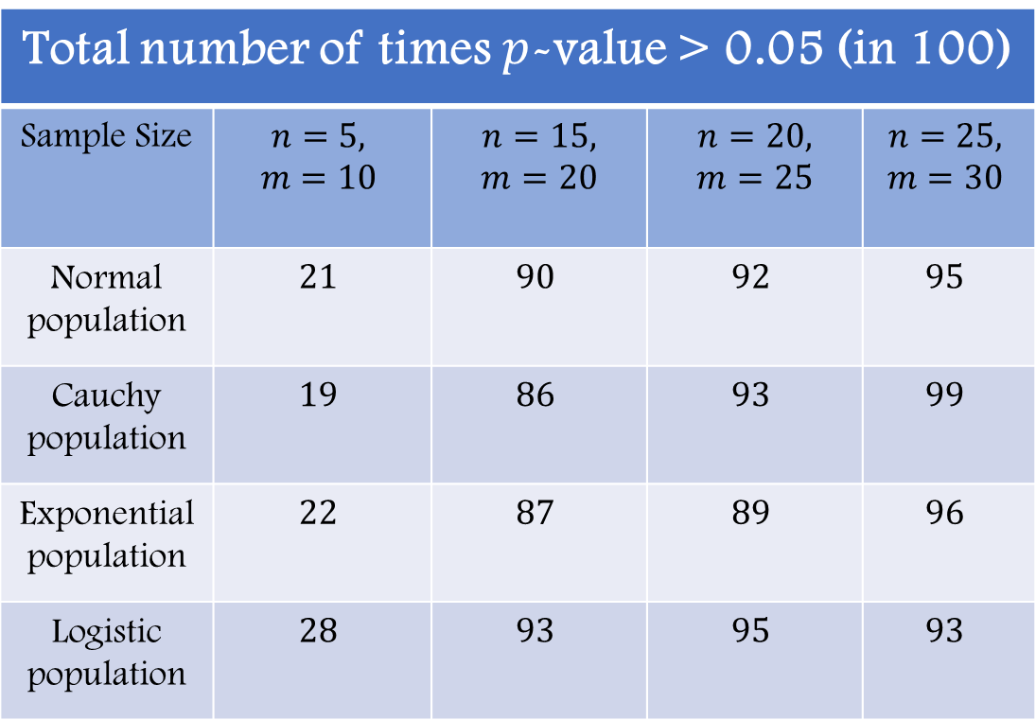
Observations:
For samples from Normal distribution, in $90\%$ cases, $T$ attains normality at $n=15, m=20.$
For samples from Cauchy distribution, in $93\%$ cases, $T$ attains normality at $n=20, m=25.$
For samples from Exponential distribution, in $96\%$ cases, $T$ attains normality at $n=25, m=30.$
For samples from Logistic distribution, in $93\%$ cases, $T$ attains normality at $n=15, m=20.$
Total number of times $p$-value > 0.05 (in 100)
Sample Size | $$n=5,$$ $$m=10$$ | $$n=15,$$ $$m=20$$ | $$n=20,$$ $$m=25$$ | $$n=25,$$ $$m=30$$
Normal population | $$21$$ | $$90$$ | $$92$$ | $$95$$
Cauchy population | $$19$$ | $$86$$ | $$93$$ | $$99$$
Exponential population | $$22$$ | $$87$$ | $$89$$ | $$96$$
Logistic population | $$28$$ | $$93$$ | $$95$$ | $$93$$

Slide 34

Parametric Counterpart
Consider the following statistic:
$$T_{p}=\frac{t}{\sqrt{\frac{m+n−2}{\left(m+n−2\right)−2}}}$$
To verify through simulation study if $T_{p}$ asymptotically follows a $N(0,1)$ distribution under $H_{0}:θ=0.$
For that, we increase the total sample size, and draw samples from each of the $4$ distributions $1000$ times for each sample size.
We check whether sampling distribution of $1000$ obtained values of $T_{p}$ is normal or not through histograms and Shapiro-Wilks Test.

Slide 35



Both sided Test$(n=5,m=10)$
Observations :
The histograms corresponding to the $4$ distributions do not seem to be similar.
$p$-values for Shapiro-Wilks test:
Normal: $1.415×{10}^{−7}$
Cauchy:$2.448×{10}^{−15}$
Exponential: $8.773×{10}^{−17}$
Logistic: $2.979×{10}^{−5}$
$p$- values for $2$ sample Kolmogorov-Smirnov test are:
Normal-Cauchy: $0.0906$
Normal-Exponential: $0.6434$
Normal-Logistic: $0.3591$
Cauchy-Exponential: $0.5621$
Cauchy-Logistic: $0.0388$
Exponential-Logistic: $0.0821$

Slide 36



Both sided Test$(n=15,m=20)$
Observations :
The histograms corresponding to the $4$ distributions do not seem to be similar.
$p$-values for Shapiro-Wilks test:
Normal: $0.611$
Cauchy:$4.01×{10}^{−26}$
Exponential: $1.93×{10}^{−4}$
Logistic: $0.163$
$p$- values for $2$ sample Kolmogorov-Smirnov test are:
Normal-Cauchy: $0.0098$
Normal-Exponential: $0.3591$
Normal-Logistic: $0.0014$
Cauchy-Exponential: $0.5352$
Cauchy-Logistic: $0.0017$
Exponential-Logistic: $0.1861$

Slide 37



Both sided Test$(n=25,m=30)$
Observations :
The histograms corresponding to the $4$ distributions do not seem to be similar.
$p$-values for Shapiro-Wilks test:
Normal: $0.173$
Cauchy:$3.57×{10}^{−29}$
Exponential: $0.503$
Logistic: $0.789$
$p$- values for $2$ sample Kolmogorov-Smirnov test are:
Normal-Cauchy: $0.0214$
Normal-Exponential: $0.0027$
Normal-Logistic: $0.0014$
Cauchy-Exponential: $0.5352$
Cauchy-Logistic: $0.0017$
Exponential-Logistic: $0.9841$
(From the $p$-values of Kolmogorov- Smirnov test, the statistic does not seem to be distribution free)

Slide 38


Observations:
For samples from Normal distribution, in $92\%$ cases, $T$ attains normality at $n=25, m=30.$
For samples from Cauchy distribution, even for large sample sizes like $n=40,m=50$, this percentage is about $2\%.$
For samples from Exponential distribution, in $90\%$ cases, $T$ attains normality at $n=25, m=30.$
For samples from Logistic distribution, in $93\%$ cases, $T$ attains normality at $n=25, m=30.$
Total number of times $p$-value > 0.05 (in 100)
Sample Size | $$n=5,$$ $$m=10$$ | $$n=15,$$ $$m=20$$ | $$n=25,$$ $$m=30$$
Normal population | 21 | 86 | 92
Cauchy population | 1 | 0 | 0
Exponential population | 1 | 81 | 90
Logistic population | 38 | 90 | 93

